Slide 1

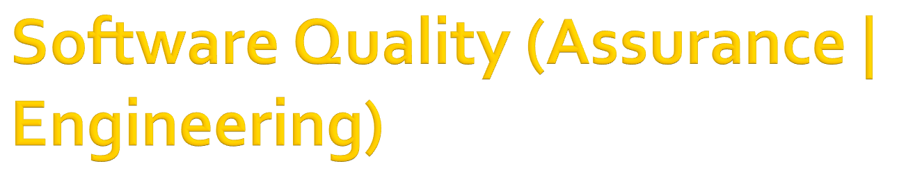
In the name of Allah, the Beneficent, the Merciful
CSE312
Lecture 2: Software Quality Standards

Slide 2

High quality software meets the needs of users while being reliable, well supported, maintainable, portable, and easily integrated with other tools.
Is higher quality better? Is it more expensive?
  Not always
We will look at how to achieve quality, the trade-offs involved, modelling quality improvement, and standards designed to ensure quality.

Slide 3

Making changes to improve software quality requires time and money to:
    • Spot the problem
    • Isolate its source
    • Connect it to the real cause
    • Fix the requirements, design, and code
    • Test the fix for this problem
    • Test the fix has not caused new problems
    • Change the documentation

Slide 4

Meeting the needs of users (not to mention marketing) requires adding features
However, given a fixed amount of development time and money, adding features adds bugs and reduces time for testing

Slide 5

But is increasing quality always more expensive, in terms of total cost of production and maintenance?
  No.
In fact, if you focus on quality from the start, then:
  • You tend to produce components with fewer defects, so
  • You spend less time in debugging, so
  • You have more time in your schedule for improving
  other aspects of quality, like usability

Slide 6

If you don’t focus on product quality then:
  • You tend to produce components with more (hidden) defects, so
  • You have to spend more time fixing these (late), so
  • You have little time for anything else, so
  • You produce poor quality software even though you put huge amount of effort into defect checking

Slide 7

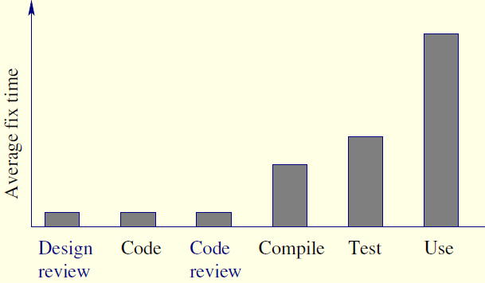
Thus it makes sense to focus on improving component quality before testing, to catch difficult defects early

Slide 8

According to the IEEE Comp. Soc. Software Engineering Standards Committee a standard can be:
    • An object or measure of comparison that defines or represents the magnitude of a unit
    • A degree or level of required excellence or attainment

Slide 9

ANSI: American National Standards Institute. Does not itself make standards but approves them
AIAA: American Institute of Aeronautics and Astronautics (e.g. AIAA R-013-1992 Recommended Practice for Software Reliability).
EIA: Electronic Industries Association (e.g. EIA/IS-632 Systems Engineering)
IEC: International Electrotechnical Commission (e.g. IEC 61508 Functional Safety - Safety-Related Systems)
IEEE: Institute of Electrical and Electronics Engineers Computer Society Software Engineering Standards Committee (e.g. IEEE Std 1228-1994 Standard for Software Safety Plans)
ISO: International Organization for Standardization (e.g. ISO/IEC 2382-7:1989 Vocabulary-Part 7: Computer Programming)

Slide 10

In practice, quality requirements of software products are often describe in vague terms
As a consequence, it is difficult for test engineers to verify the quality of the software product against these requirements

Slide 11

In 1977 McCall , Richards, and Walters proposed the idea of break down of quality concept as quality factors
  The idea has been followed by many authors by imposing their own hierarchically layered model of software product quality
ISO and IEC have defined standard set of quality characteristics
This ISO 9126 standard (ISO 9126-1 2001) defines six quality characteristics and the subdivision of each quality characteristics into sub characteristics

Slide 12


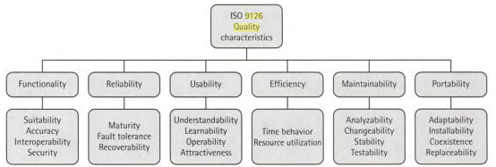

Slide 13

Functionality Characteristics relating to achievement of the basic purpose for which the software is being engineered
  Suitability is the presence and appropriateness of a set of functions for specified tasks
  Accuracy is the provision of right or agreed results or effects
  Interoperability is the Software’s ability to interact with specified systems
  Security is the ability to prevent unauthorized access, whether accidental or deliberate, to programs and data.

Slide 14

The accuracy for a GPA calculator for a university’s exam department should be up to 2 decimal point

Slide 15

Reliability Characteristics relating to capability of software to maintain its level of performance under stated conditions for a stated period of time
  Maturity is the attribute of software that bear on the frequency of failure by faults in the software
  Fault tolerance is the ability to maintain a specified level of performance in cases of software faults or unexpected inputs
  Recoverability is the capability and effort needed to re-establish level of performance and recover affected data after possible failure

Slide 16

The failure frequency of a heart-monitoring unit that will operate in a hospital’s intensive care ward is required to be less than one in 20 years.
Its heart attack detection function is required to have a failure rate of less than one per million cases.

Slide 17

Usability Characteristics relating to the effort needed for use, and on the individual assessment of such use, by a stated or implied set of users.
  Understand ability is the effort required for a user to recognize the logical concept and its applicability
  Learn ability is the effort required for a user to learn its application, operation, input, and output
  Operability is the ease of operation and control by users
  Attractiveness is the capability of the software to be attractive to the user

Slide 18

The usability requirements for the new help desk system initiated by a home appliance service company lists;
  A staff member should be able to handle at least 60 service calls a day.
  Training a new employee will take no more than two days (16 training hours), immediately at the end of which the trainee will be able to handle 45 service calls a day.

Slide 19

Efficiency Characteristic related to the relationship between the level of performance of the software and the amount of resources used, under stated conditions
  Time behaviour is the speed of response and processing times and throughput rates in performing its function
  Resource utilization is the amount of resources used and the duration of such use in performing its function

Slide 20

An outdoor meteorological unit, equipped with a 1000 milli-ampere hour cell, should be capable of supplying the power requirements of the unit for at least 30 days
The system performs measurements once per hour, logs the results, and transmits the results once a day to the meteorological center by means of wireless communication

Slide 21

Maintainability Characteristics related effort needed to make modifications, including corrections, improvements or adaptation of software to changes in environment, requirements and functional specifications
  Analyzability is the effort needed for diagnosis of deficiencies or causes of failures, or for identification parts to be modified
  Changeability is the effort needed for modification fault removal or for environmental change
  Stability is the risk of unexpected effect of modifications
  Testability is the effort needed for validating the modified software

Slide 22

Typical maintainability requirements:
  The size of a software module will not exceed 30 statements
  The programming will adhere to the company coding standards and guidelines

Slide 23

Portability Characteristics related to the ability to transfer the software from one organization or hardware or software environment to another
  Adapt ability is the opportunity for its adaptation to different specified environments
  Install ability is the effort needed to install the software in a specified environment
  Co-existence is the capability of a software product to co-exist with other independent software in common environment
  Replace ability is the opportunity and effort of using it in the place of other software in a particular environment

Slide 24

A software package designed and programmed to operate in a Windows 8 environment is required to allow low-cost transfer to CentOS and Windows 10 environments

Slide 25

Summary

